Slide 1
Title
Team Members:
B.PRASANTH(RA2211004050008)
E.G.PRADEEP(RA2211004050026)
Guided by,
DR.M.MATHAN KUMAR
Assistant Professor
DEPT OF ECE

Slide 2
ABSTRACT

Slide 3
INTRODUCTION

Slide 4
BLOCK DIAGRAM
0.96 12C OLED DISPLAY
DH11 SENSOR
STM32 MICROCONTROLLER
STM32 MICROCONTROLLER
LR1278/SX1278
LR1278/SX1278

Slide 5
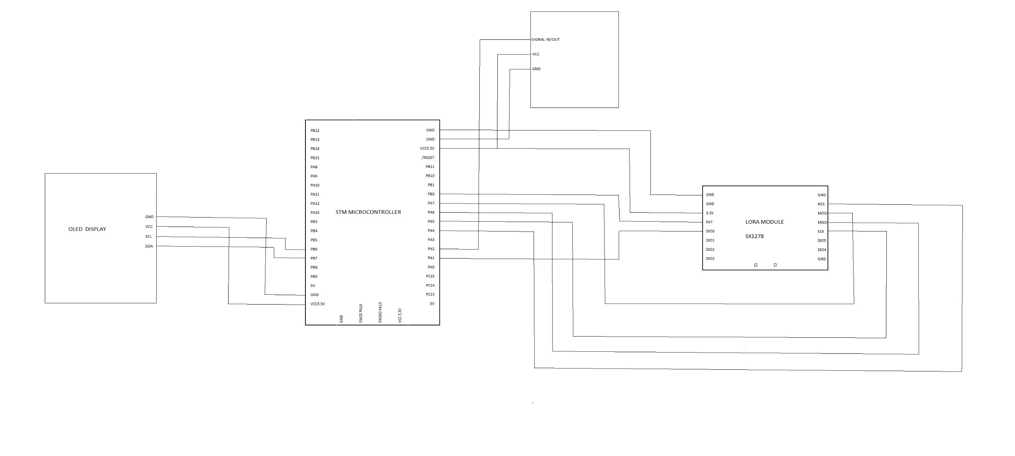
CIRCUIT DIAGRAM

